Slide 1
SOEN 423
Distributed Systems
Java RMI
Tutorial 2
Shivaraj Mallikarjun Alagond
Credits: Akriti Saini

Slide 2
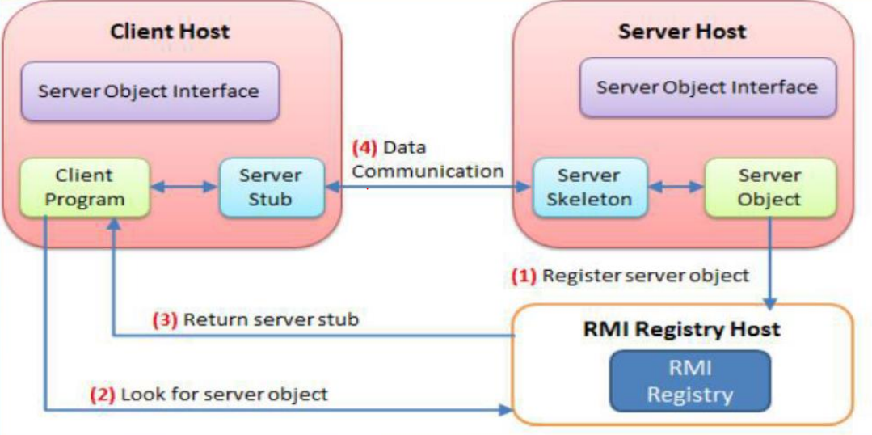
Basic Architecture

Slide 3
Basic Concepts
Java RMI: Java RMI allows a java object that executes on one machine to invoke method on a java object that executes on another machine.
Client: It invokes the method on remote object.
Server: It owns the remote object
Registry: Naming server that relates objects with unique names.

Slide 4
Concepts
Server object interface: An interface defines the method for the server Object.
Server Object: An instance of the server object interface.
Server Stub: An object resides on the client host and acts as a representative of the remote server object.
Server Skeleton: An Object that resides on the server host. It communicates with the stub and the actual server object.
RMI Registry: It is service to register remote objects and to provide naming services for locating objects.
Client Program: A program that invokes the methods in the remote server object.

Slide 5
Steps:
Implementation
Define the Interface
Implement the Server
Implement the Client
B. Execution
Run RMI Registry
Run the Server
Run the Client

Slide 6
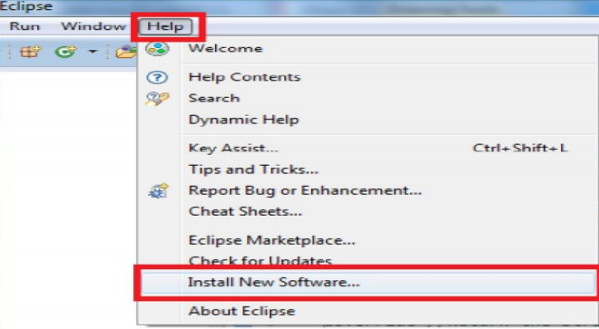
Installing Plugin
Open Eclipse
Select Help-> Install New Software

Slide 7
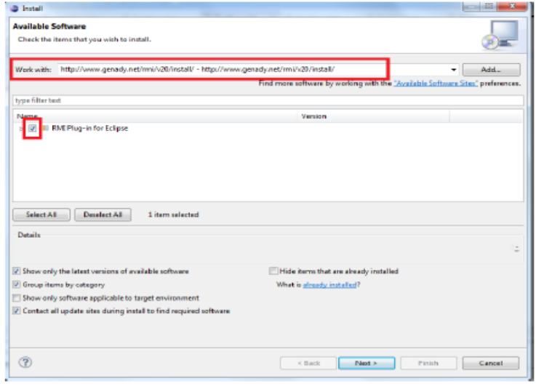
3. Enter: http://www.genady.net/rmi/v20/install/
4. Check RMI plugin for Eclipse

Slide 8
5. Accept the Terms of Service and continue.
6. You may have to restart Eclipse.
7. Troubleshooting:
You need Java SDK (1.6+) installed. The JRE does not provide Tools.jar which is essential to Java RMI.
8. Your CLASSPATH variable must remain undefined.

Slide 9
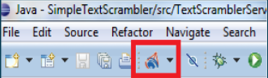
If successful, you will see the following when you re-open Eclipse:
This will enable you to start a local registry manually

Slide 10
RMI Exercise

Slide 11
Objective:
The objective of today's tutorial is to successfully run RMI distributed system which gives addition of two numbers to the client.
Note that this tutorial is designed in a very simple fashion. For your assignment, you are expected to structure your code(put files in relevant packages) and modify it as per your need.

Slide 12
Steps:
1. Create the remote interface.
2. Implementation of Remote Interface
3. Create Server
4. Create Client
5. Run RMI plugin
6. Run Server and then client.

Slide 13
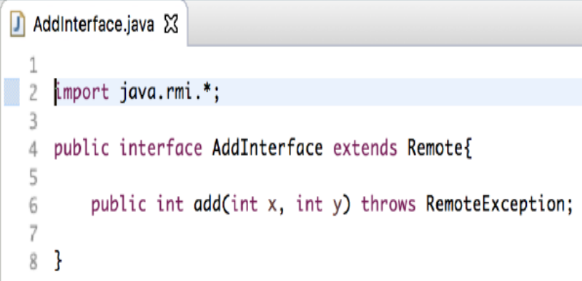
Create the Remote Interface

Slide 14
Extend Remote Class belongs to (java.RMI) package in your Interface
Implement the interface in the class which you want with remote functionality
The remote interface serves to identify interfaces whose methods may be invoked form a non-local virtual machine. Any object that is a remote object must directly or indirectly implement this interface. Only those methods specified in a "remote interface", an interface that extends java.rmi. Remote are available remotely.
Your methods now potentially throw RemoteException. You must declared them explicitly

Slide 15
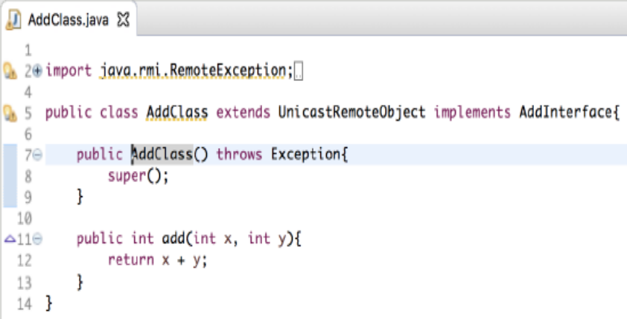
2. Implementation of Remote Interface

Slide 16
UnicastRemote Object:
Used for exporting a remote object with JRMP(Java Remote Method Protocol) and obtaining a stub that communicates to the remote object.

Slide 17
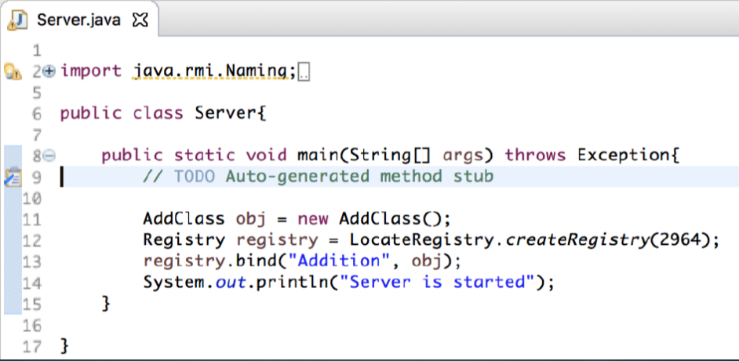
3. Create Server

Slide 18
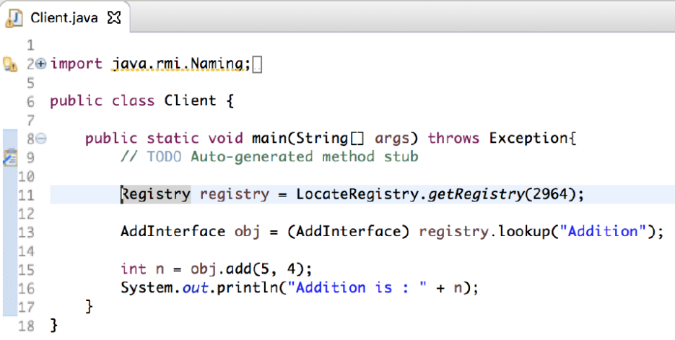
4. Create Client:

Slide 19
On the Client:
The client must fetch the server from the registry
If successful, the client will be able to use the methods residing on the server

Slide 20
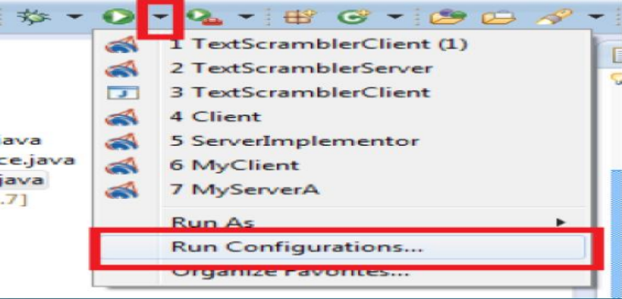
5. Configure RMI Plugin
Now to start our server we have to create a special RMI configuration

Slide 21
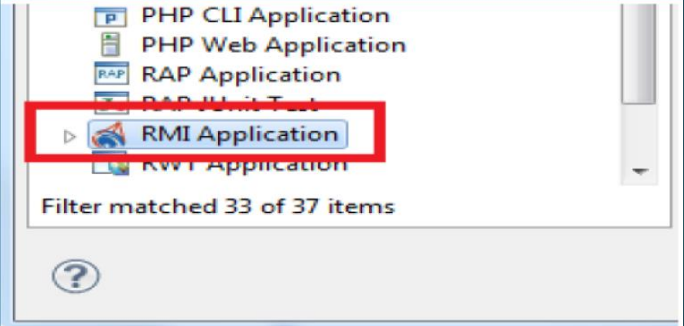
Double Click on RMI Application

Slide 22
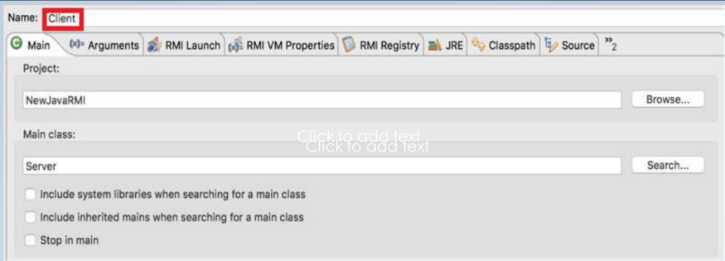
Name your configuration – Client
Select the appropriate main class by clicking on search

Slide 23
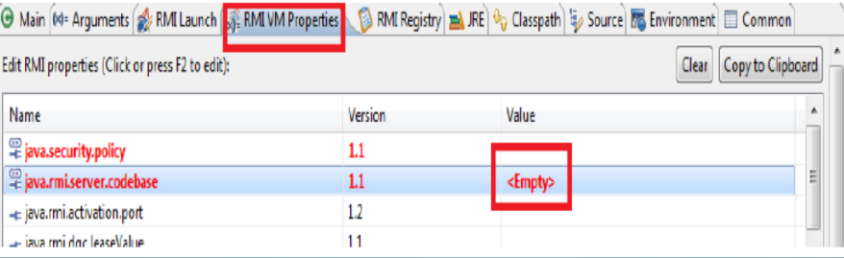
Next you have to select RMI VM properties and click on the <Empty> to set a codebase

Slide 24
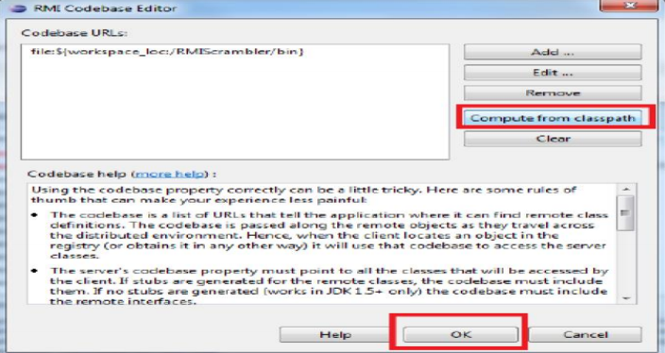
Click on Compute from ClassPath and then OK.

Slide 25
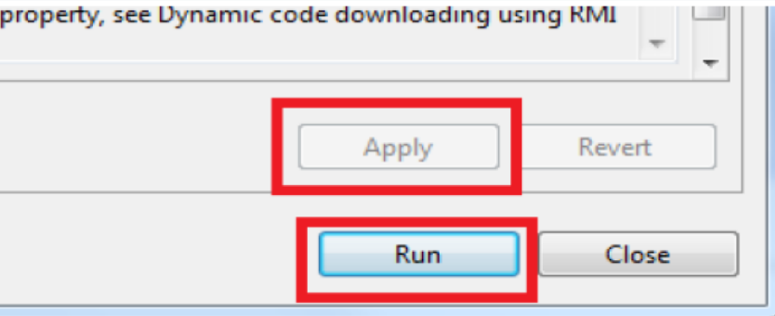
Then Click on Apply and Run. The server will start

Slide 26
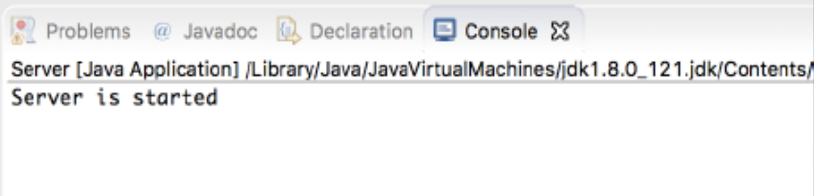
6. Run Server and then Client
Successful setup of server
Output

Slide 27
Client:
For the client, you do not have to set the classpath. However, you do have to provide a security.
To do so, go back to run configuration, double click on RMI Application and then RMI VM properties.

Slide 28
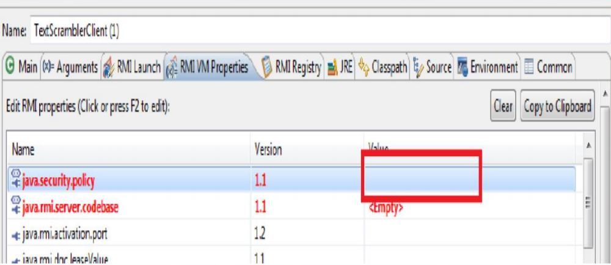
Security Policy
Click right above the <Empty>

Slide 29
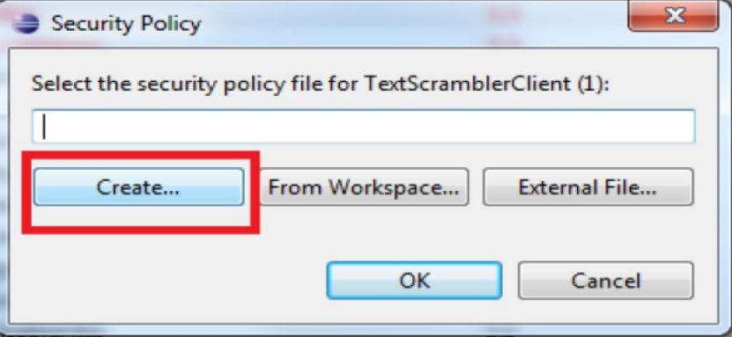
Create a New Security Policy

Slide 30
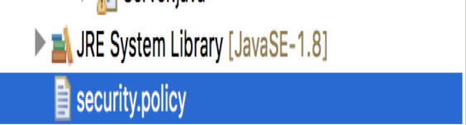
Successful setup of security Policy
If successful you will see the following:

Slide 31
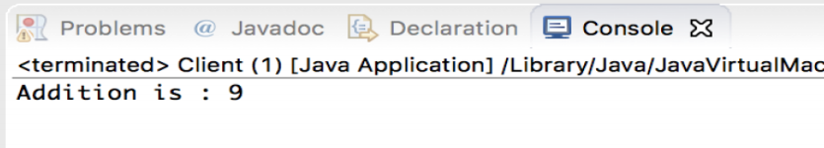
Starting New Client
You may now start the client
Output

Slide 32
Reference Link
https://docs.oracle.com/javase/tutorial/rmi/
https://www.java-tutorial.com/

Slide 33
Thank You…

